Slide 1
CS401 Lab 3/30/20
These slides will be available online:
https://github.com/kc13/CS401PF
Agenda for today:
Remember to submit lab to kmc51@pitt.edu
ASAP, if you haven’t submitted yet
This was the Car Dealer App, part I
Added note 3/30: If you encounter problems when sending this over email, try uploading it to a cloud storage service (Pitt has Box and OneDrive, but you can also use other services like Google Drive) and generate a link that you can use to share it (and then email the link).
Comments on the next lab assignment
Car Dealer App, part II

Slide 2
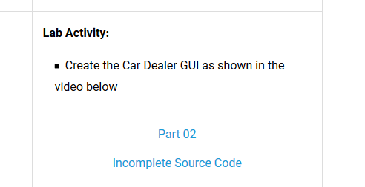
Assignment: Car Dealer GUI Part 2 – see video link and partially completed code on the website
Comparison to Part I:
More elaborate, functional user interface
Not quite as detailed of a walk through in the video (this time you have to figure more out on your own or with help from Google searches – the video primarily serves to show you what you’re trying to create.)
The purpose of these slides will be to provide some hints beyond those provided in the video.

Slide 3
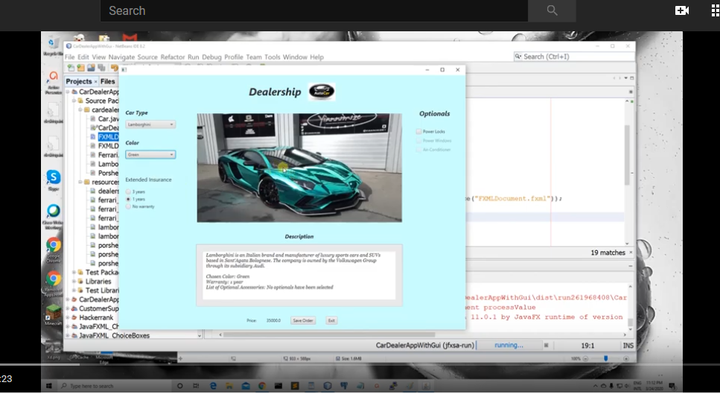
Car Dealer GUI Part 2 – end goal (2:14 in video)
The next several minutes of the video describe how this interface should behave.

Slide 4
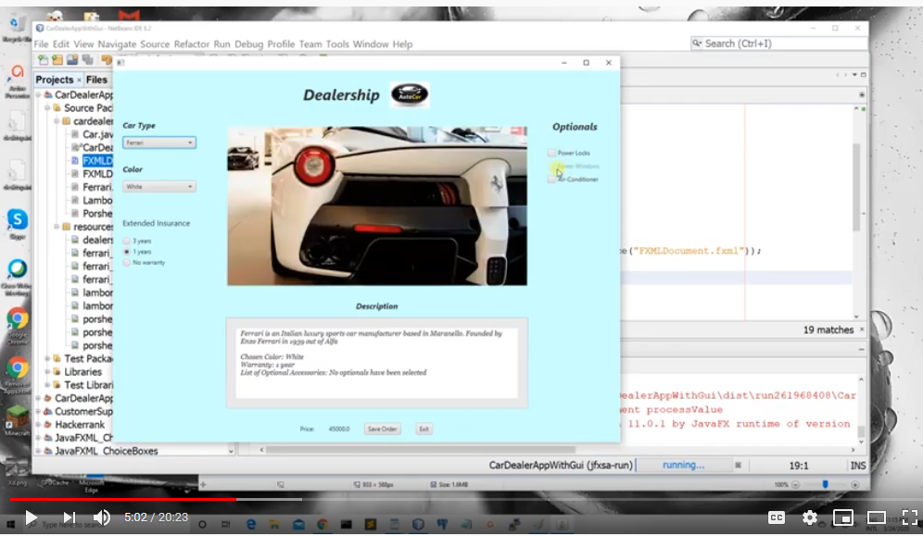
Car Dealer GUI Part 2 – around 5:00 in the video
There is a comment about how options should be disabled if they are factory defaults. (See Power Windows in the example.)
Note there is a setDisable() method for the CheckBox class:
https://docs.oracle.com/javase/8/javafx/api/javafx/scene/Node.html#setDisable-boolean-

Slide 5
Car Dealer GUI Part 2 – some highlighted comments from video
Note comment at around 6:00 about the animated GIFs that are used – these are in the same zip archive as the incomplete code (see \src\resources\images)

Slide 6
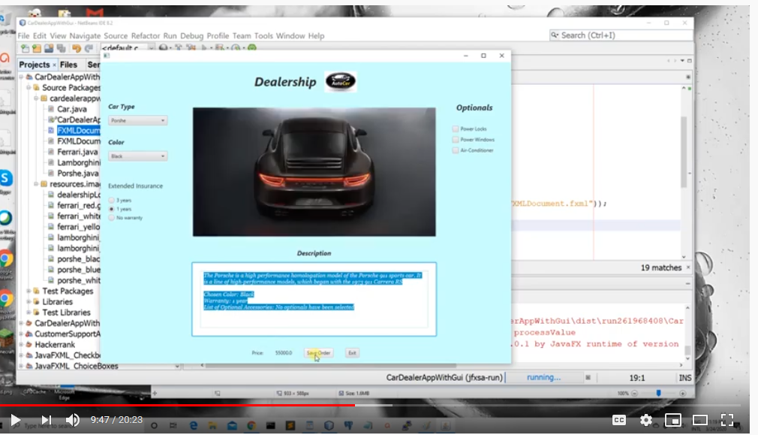
Car Dealer GUI Part 2 – some highlighted comments from video
Around 9:30: The user should be able to save out information from the Description, and the Price.
This is going to happen in a method that evokes the FileChooser.
Here is one reference: https://docs.oracle.com/javafx/2/ui_controls/file-chooser.htm
The “Saving Files” section is most relevant. (See next slide.)

Slide 7
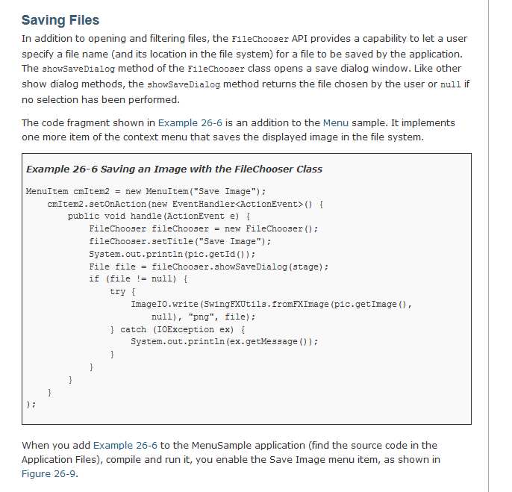
From https://docs.oracle.com/javafx/2/ui_controls/file-chooser.htm
You will need to adjust for the fact that you need to save a text file, rather than an image.
You can use “null” as the argument to showSaveDialog().

Slide 8
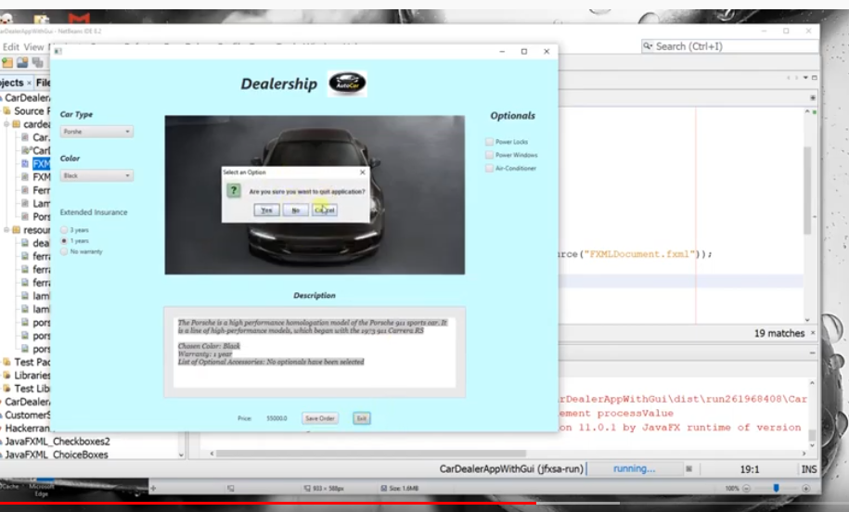
Car Dealer GUI Part 2 continued
At approximately 12:20 the video starts describing a confirmation dialog to confirm that the user does indeed want to exit the program. You are instructed to use JOptionPane.showConfirmDialog for this.

Slide 9
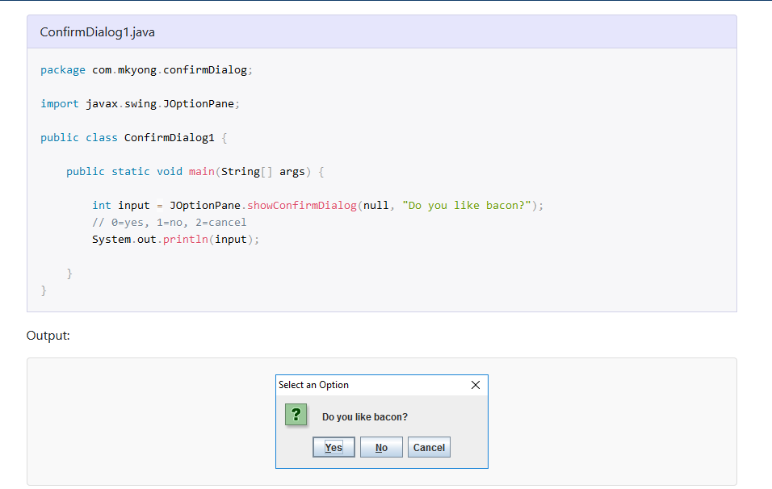
Car Dealer GUI Part 2 continued
Here is an example usage from https://mkyong.com/swing/java-swing-how-to-make-a-confirmation-dialog/
In your case, you want to test if the integer returned from the method (here named “input”) is equal to 0 (‘yes’). If it is, you exit the program.

Slide 10
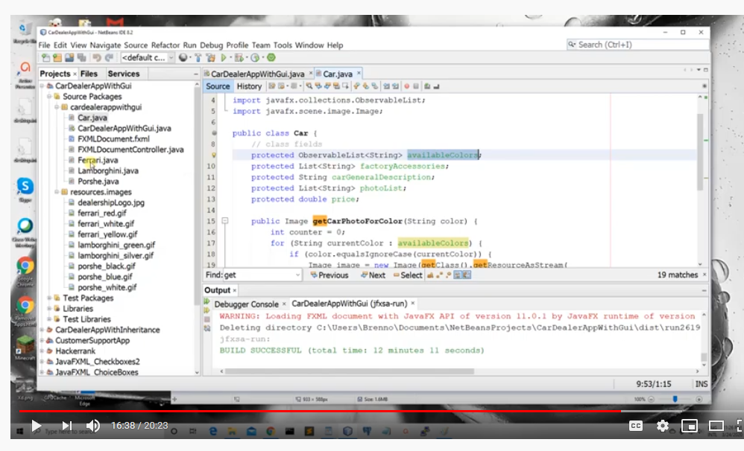
Car Dealer GUI Part 2 continued
At approximately 16:30: Makes reference to the line protected ObservableList<String> availableColors;
in the Car class.
You will need to instantiate this variable in the classes that extend upon Car (e.g., Lamborghini). You can do this using:
availableColors = FXCollections.observableArrayList(<some array of strings>);

Slide 11
A few comments on some of the code that will need to be added to the incomplete code that is provided.
Not exhaustive! (You’ll need to add a lot more than what I mention here.)
Focusing on FXMLDocumentController.java (but you’ll have to add to other files as well)

Slide 12
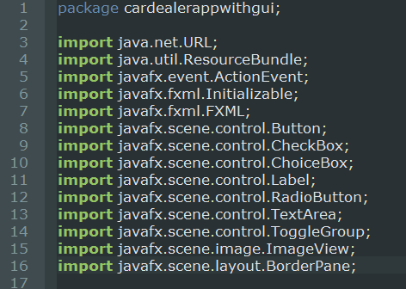
FXMLDocumentController.java
Expect that the list of imports will grow well beyond what you initially see in the incomplete code.

Slide 13
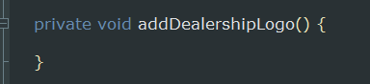
FXMLDocumentController.java
You’ll need to create new Image instance, use the setImage method of ImageView, and set the setStyle method of BorderPane.

Slide 14
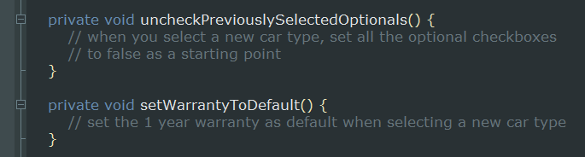
FXMLDocumentController.java
For both of these you can make use of the setSelected() methods of the appropriate classes (CheckBox/RadioButton).

Slide 15
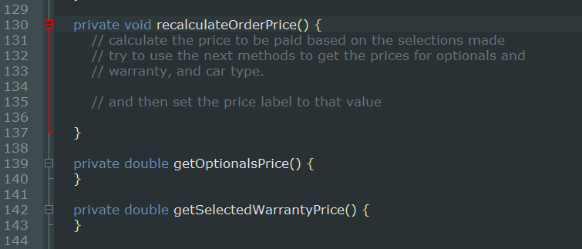
FXMLDocumentController.java
All of these methods will involve calling other methods, and then using the information returned from those methods to update the appropriate price.

Slide 16
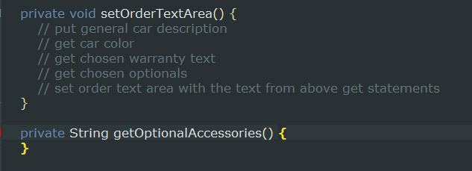
FXMLDocumentController.java
Both of these methods will involve putting together strings based on information returned from other methods (so you’ll likely want to use some StringBuilder objects).

Slide 17
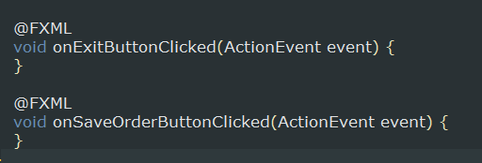
FXMLDocumentController.java
The first method is where you’ll make use of the JOptionPane.showConfirmDialog method from the earlier slide.
The second method is where you’ll make use of the FileChooser.

Slide 18
Car Dealer GUI: submission for this lab
Your project should roughly match what is shown in the video.
The main priority should be mimicking the functionality that is shown. Minor differences in the GUI’s appearance won’t be counted against the grade for this lab.
As usual, partial credit will be given for partially completed assignments.
Compress your NetBeans project (.zip or something else) and send it to kmc51@pitt.edu
Deadline: End of 4/6 lab (10:50 or 12:50 pm, depending on your section)

